Slide 1
Broadband User Database Management
Course Title: Database System Laboratory
Course Code: CSE 3210
Submitted To:
Nawaz Talukder Sanglap Lecturer Department of Electronics and Communication Engineering
Md. Badiuzzaman Shuvo Lecturer Department of Computer Science and Engineering
Submitted By:
Shuva Podder
Roll No. : 1909051
Session: 2021-22
3rd Year, 2nd Sem.
Department of Electronics and Communication Engineering

Slide 2
Introduction
Internet has nowadays become an essential part of everyday life. Broadband Internet Connection is more or less common in every house to corporate offices. ISP or Internet Service Providers serve a wide range of users. To keep record of that vast number of users, database can play an essential role. The objective of this project is to develop a DBMS that will store each required data in a systematic way and optimize the efficiency of the ISP.

Slide 3
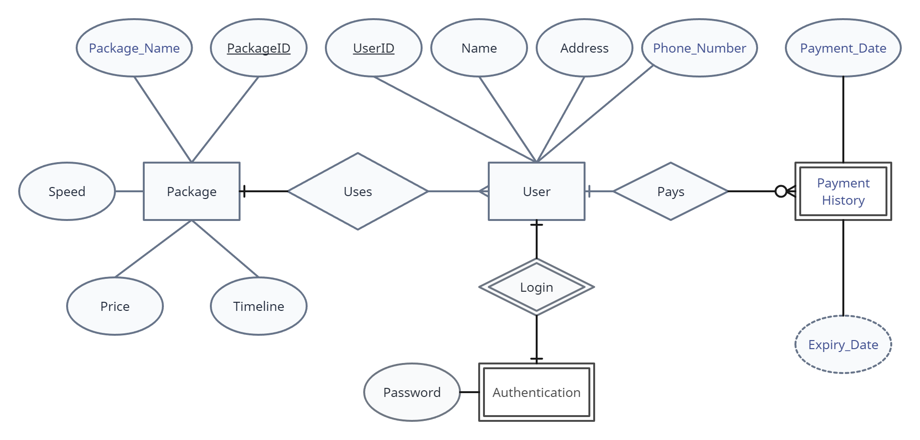
E-R Diagram

Slide 4
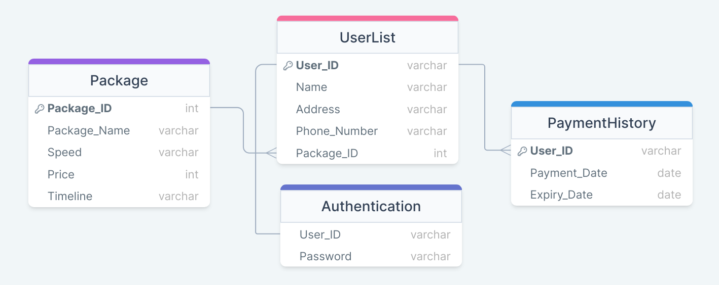
Schema Diagram

Slide 5
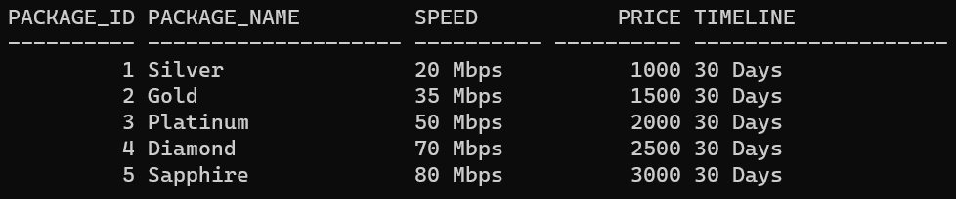
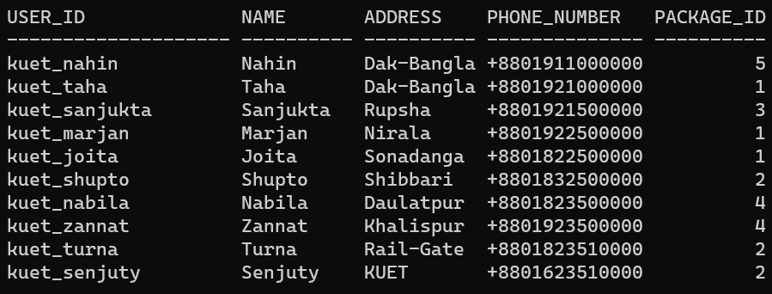
Tables
Package
UserList

Slide 6
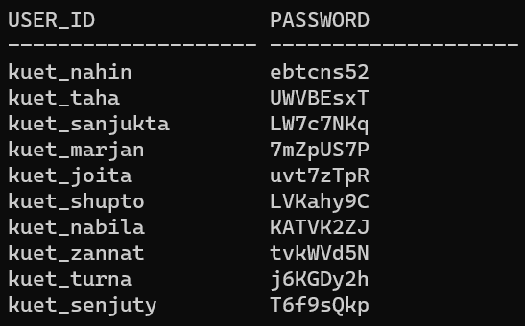
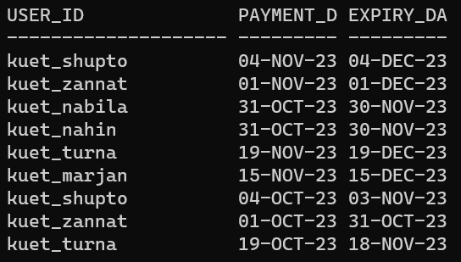
Tables
Authentication
UserList

Slide 7
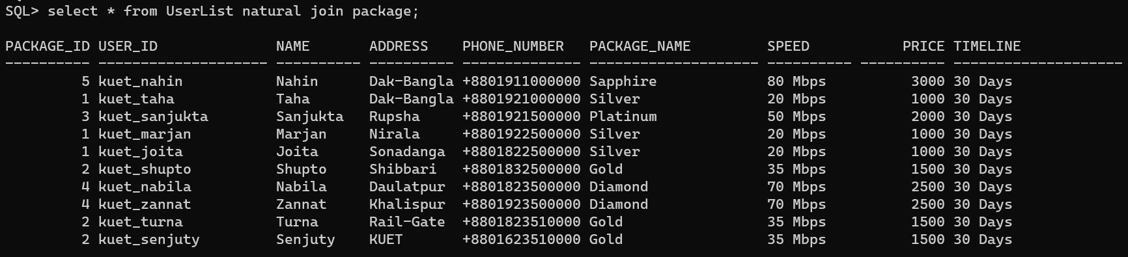
Views (Generated using SQL)
Showing the details of the user including the package and its details

Slide 8
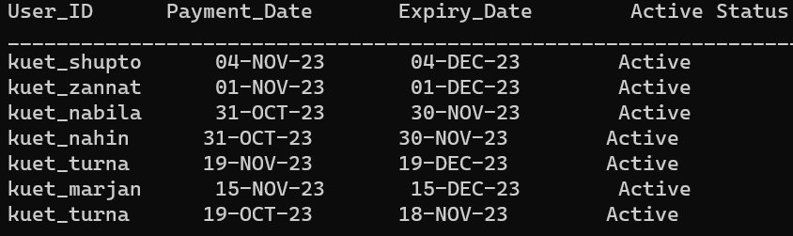
Views (Generated using PL/SQL)
Showing the users that are currently using the broadband service

Slide 9
Thank You

